Slide 1
predicting drug–target binding affinity with graph neural networks
Presented by: Youssef Ezz Eldeen Ezzat
Directed By: Francesc Seratosa

Slide 2
Contents
Introduction
Paper
Data representation
Model
Results

Slide 3
Introduction
A virus encodes one or more proteases which are enzymes that spur the formation of new protein products, thus play crucial roles in virus replication
proteases are important targets for the design and development of potent antiviral agents or drugs

Slide 4
Introduction
Binding affinity is the strength of the binding interaction between a single molecule (e.g., a virus protein) to its ligand or binding partner (e.g., a drug)

Slide 5
featurizing drug molecule
In order to perform machine learning on molecules, we need to transform them into feature vectors that can be used as inputs to models
SMILES notation
Molecular graph

Slide 6
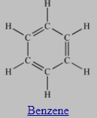
SMILES notation
“Simplified Molecular-Input Line-Entry System”
popular method for specifying molecules with text strings.
invented to represent molecules to be readable by humans and computers
Methane: "C"
Ethanol: "CCO"
Benzene: "c1ccccc1“
Glucose: "OC[C@@H]1OC@HC@@HC@H[C@H]1O"
Notes:
A SMILES string describes the atoms and bonds of a molecule in a way that is both concise and reasonably intuitive to chemists.

Slide 7
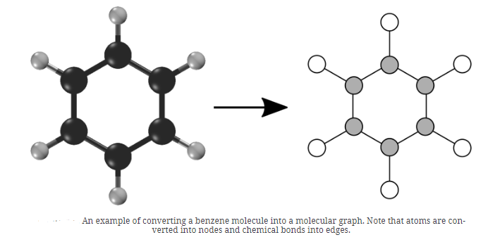
molecular graph
A molecular graph describes the set of atoms in a molecule and how they are bonded together
G = (V,E), where V is the set of N nodes and E is the set of edges represented as an adjacency matrix A
Notes:
Any molecule can be converted into a corresponding molecular graph. in order to analyze them and learn to make predictions about them.
A molecular graph describes the set of atoms in a molecule and how they are bonded together.

Slide 8
Previous Work
collaborative filtering (2017): the SimBoost model uses the affinity similarities among drugs and among targets to build new features.
DeepDTA model (2018): uses 1D representations and layers of 1D convolutions (with pooling) to capture predictive patterns within the data
WideDTA model (2019):extension of DeepDTA in which the sequences of the drugs and proteins are first summarized as higher-order features
Notes:
In the context of the SimBoost model, collaborative filtering is used in the following way:
Drug-Drug Affinity Similarities:
The model calculates the affinity similarities between all pairs of drugs based on their known interactions with targets.
This affinity similarity captures the idea that drugs with similar binding profiles are likely to have similar interactions with targets.
The drug-drug affinity similarities are then used to build new features for the prediction model.
Target-Target Affinity Similarities:
Similar to the drug-drug affinity similarities, the model also calculates the affinity similarities between all pairs of targets based on their known interactions with drugs.
The target-target affinity similarities capture the idea that targets with similar binding profiles are likely to have similar interactions with drugs.
These target-target affinity similarities are also used to build new features for the prediction model.
Feature Engineering:
The drug-drug and target-target affinity similarities are used to create new features for the prediction model.
For example, for a given drug-target pair, the model can use the average affinity similarity between the drug and all other drugs that interact with the target, as well as the average affinity similarity between the target and all other targets that interact with the drug.
These collaborative filtering-based features capture the idea that a drug-target interaction is more likely if the drug and target have similar affinities to other drugs and targets, respectively.
By incorporating these collaborative filtering-based features, the SimBoost model is able to leverage the inherent relationships and similarities among drugs and targets to improve the accuracy of predicting new drug-target interactions.

Slide 9
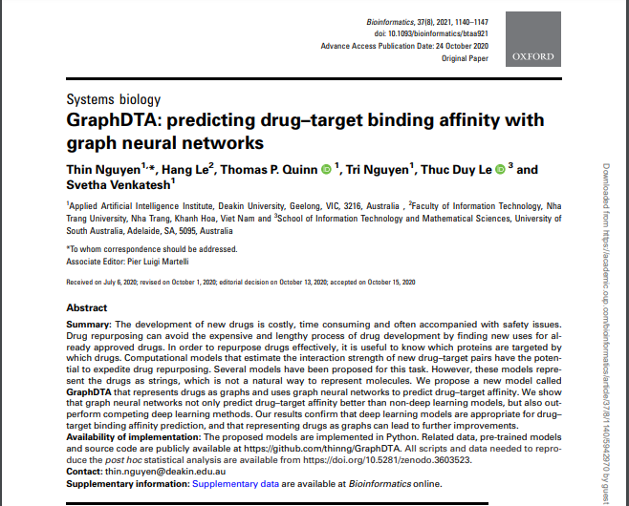
GraphDTA paper overview
a new neural network architecture capable of directly modeling drugs as molecular graphs
outperforms previous deep learning models.
directly modeling drugs as molecular graphs
Bioinformatics, Volume 37, Issue 8, March 2021, Pages 1140–1147, https://doi.org/10.1093/bioinformatics/btaa921

Slide 10
Datasets
Benchmark dataset davis
Benchmark dataset kiba
In house dataset URV

